Slide 1


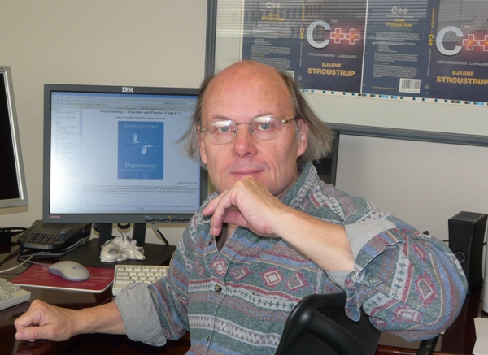
Mach7: The Design and Evolution of a Pattern Matching Library for C++
Yuriy Solodkyy • Gabriel Dos Reis • Bjarne Stroustrup
Microsoft Microsoft Morgan Stanley
Developed at Texas A&M University
May 14, 2014
C++ Now 2014, Aspen, CO
Partially supported by NSF grants: CCF-0702765, CCF-1043084, CCF-1150055
Open-sourced under BSD License
http://parasol.tamu.edu/mach7/ https://github.com/solodon4/SELL
Notes:
Hi, my name is Yuriy and today I would like to present the work we did in collaboration with Dr. Dos Reis and Dr. Stroustrup at Texas A&M University on pattern matching for C++.

Slide 2
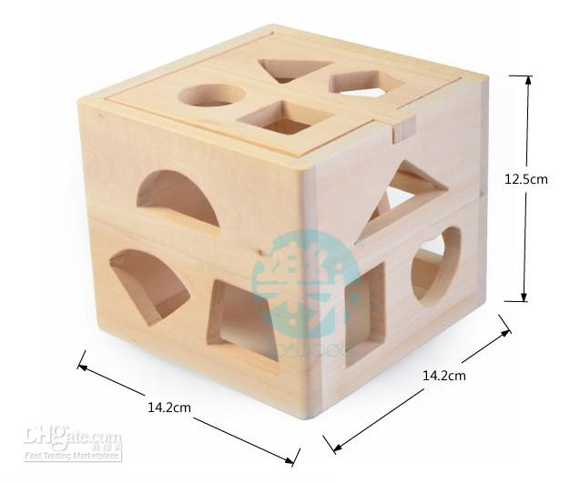
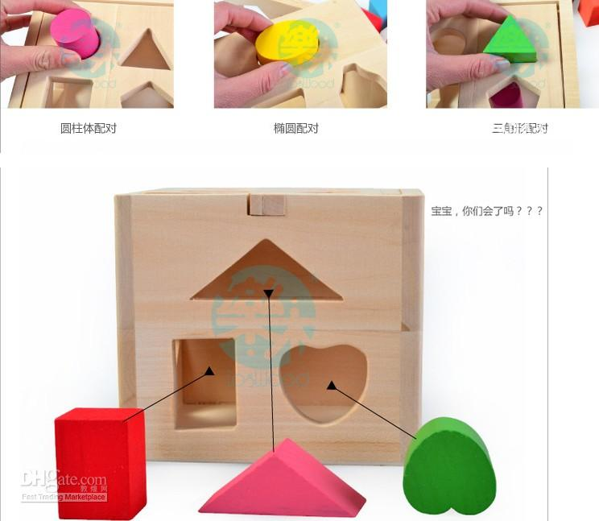
Introduction
What is pattern?
Pattern – some breve notation for a structure of interest
Implied argument – the subject
Composition
Subject – an entity with expected structure
What is pattern matching?
Efficient decision procedure determining which of the given set of patterns match a given subject
Notes:
By pattern we mean any concise notation capable of recognizing and decomposing some structure of interest. They are often a predicate of one-time use, but unlike lambda functions have implicit argument – the subject. Pattern matching is the efficient decision procedure that the compiler generates based on patterns in order to check whether the subject matches the described structure.

Slide 3
Examples of Patterns / Subjects
File mask / file
*.?pp
Regular expression / string
[A-Za-z_][A-Za-z_0-9]+
Grammar / program
exp : exp + exp | exp – exp
Mathematical notation / value
a+bi
Notes:
Some of the most well known examples of patterns and their subjects include:
File masks and file names that fit them
Regular expressions and strings are one of the oldest, stemming from SNOBOL
Grammar can also be viewed as the description of the structure of a well formed program
We can also look at certain math notation as a description of the structure of the value

Slide 4
Examples of Patterns / Subjects
Bitmask / value
(value & (A|B|C)) && !(value & (D|E|F))
Function template / arguments
template <class T> bool foo(list<T,allocator<T>>)
Exception handler / exception
try {…} catch(Car&) {} catch(Vehicle&) {} catch(…) {}
XPath / XML elements
book[/bookstore/@specialty=@style]
Schedules / time
Mon-Fri: 9am-8pm; Sat: 11am-7pm; Sun: Closed
Notes:
Bitmasks are another pattern that match all the values having that mask
In C++, there is already a functional sublanguage embedded in it that has pattern-matching facilities: templates along with classes and functions that match them (during overload resolution or partial specialization).
Exception handlers with the exceptions in C++ effectively implement first-fit semantics for open classes.
Xpath patterns and corresponding XML elements
Lattices can be viewed as patterns on the values described by those lattice elements.

Slide 5
Pattern Matching vs. Pattern Recognition
Pattern Matching
Pattern Recognition
The act of checking & decomposition of a perceived structure of a value.
PL-term
Programing Languages
Analysis in PL
Exact matching
Pre-existing patterns
Efficiency of pattern matching
1 subject, N patterns
find first/all/best pattern that matches the subject
The assignment of a label to a given input value
ML-term
Machine Learning
Synthesis in ML
Most-likely matching
Learnt patterns
Accuracy of pattern recognition
N data points, 1 pattern
find pattern that describes all/most/some of the data
A pattern obtained via Machine Learning can be encoded in a program with pattern matching constructs to perform efficient pattern recognition
Notes:
It is important to distinguish pattern matching, which is a programming languages term from pattern recognition, which is a machine learning term. This slide came to life after my interview with one very large company, which does a lot of both. I don’t know whether their software that parses CVs uses matching or recognition, but whatever it is it confuses the two. I was set up 5 times for interviews with Machine Learning teams even after I explicitly mentioned to them I have zero background in machine learning. I could not figure out what was going on for a while since I only knew the Ukrainian term for Pattern Recognition and it didn’t immediately occur to me that the word used for Pattern there is the same as the word used for pattern matching.
In pattern matching the patterns are given (pre-existing) and we are dealing with generation of the most efficient decision procedure. Pattern matching is about analysis. In machine learning we are given data, possibly categorized) and we are concerned about finding the best description that will assign categories. The resulting procedure can be approximate and we are more concerned about precision of it. Machine learning is thus about synthesis of the most precise decision procedure from data.

Slide 6
Pattern Matching Semantics
First fit
most functional languages, exceptions in C++
Best fit
overload resolution in C++
Exact fit
C-like switch statement
All/Any fit
Languages based on guarded commands etc.
Notes:
Different languages give different semantics to their pattern matching constructs. Functional languages typically prefer first-fit semantics to mimic mathematical notation for case analysis. Best-fit semantics makes ordering irrelevant, however it can be subject to ambiguities as a result. Exact fit assumes disjointedness of patterns and that at most one pattern can match at any given time. Some languages may offer to match all or any of the patterns (whether deterministically or non-deterministically).

Slide 7
Patterns in Other Languages
Mathematica
fib[0|1]:=1 fib[n_] := fib[n-1] + fib[n-2]
Haskell
take 0 _ = [] take _ [] = [] take (n+1) (x:xs) = x : take n xs
Erlang
f("prefix" ++ Str) -> ...
<<D:16,E,F>> = <<1,17,42:16>> {_N,_N} = {1,2}
Notes:
The important bit about pattern matching is there is always Right-Hand Side and Left-Hand Side. The same expression in LHS and RHS has different meanings. The expression 1 on the left of := is a value pattern that will only match a value 1. In the LHS it represents the value 1, not a pattern. Same goes about variable pattern n, which is introduced in the LHS and then the value bound to it is used in the RHS. Patterns can be composed with the help of combinators e.g. the alternative combinatory | as in 0|1. Haskell had n+k patterns, which has since been deprecated. A variation of them can also be seen with matching prefix of a string in Erlang. Most functional languages require variable patterns to happen only once in the LHS. When multiple occurences are allowed with the semantics that all of the occurrence must be bound to the same value for the pattern to match, they are called equivalence patterns. Erlang is also famous for its bit patterns, which makes it very attractive for describing network protocols etc.

Slide 8
Example: Case Analysis in FP
+
*
6
7
2
exp ::= val | exp + exp | exp - exp | exp * exp | exp / exp
type expr =
Value of int
| Plus of expr * expr
| Minus of expr * expr
| ...
;;
let rec eval e =
match e with
Value v -> v
| Plus(a,b) -> (eval a)+(eval b)
| Minus(a,b)-> (eval a)-(eval b)
| ...
;;
Pros
Elegant
Intuitive
Extensibility of functions
Checked
redundancy
exhaustiveness
Local reasoning
Relational
Cons
No extensibility of data
Not suitable for classes:
Variants are closed & disjoint
Classes are extensible & hierarchical
Notes:
To give examples of patterns and pattern matching, imagine that you would like to implement an interpreter (or calculator) of a simple expression language represented by the following grammar. In functional languages, a term in such language will typically be represented with a recursive Algebraic Data Type (ADT) with variants corresponding to production rules. Functional languages then implement various operations on expression terms (like evaluation, printing or transformation) by simple case analysis on the variants with variables used to bind to corresponding subcomponents. An evaluation function, for example, is a simple recursion that follows the structure of the term.

Slide 9
Example: Nested Matching
+
*
6
7
2
exp ::= val | exp + exp | exp - exp | exp * exp | exp / exp
xa + xb → x(a+b)
let collect e =
match e with
| Plus(Times(x1,a), Times(x2,b)) when x1=x2
-> Times(x1,Plus(a,b))
| Plus(Times(a,x1), Times(b,x2)) when x1=x2
-> Times(Plus(a,b),x1)
| e -> e
;;
Notes:
Variables are not the only entities that can be bound to subcomponents and other patterns can be used instead to check the structure of those subcomponents. This leads to nesting of patterns as demonstrated here with function collect that extracts common factor from a sum. This is also where implicitness of the argument makes the solution less verbose than same solution expressed with lambda functions.

Slide 10
Example: Relational Matching
+
*
6
7
2
exp ::= val | exp + exp | exp - exp | exp * exp | exp / exp
let rec equal e1 e2 =
match (e1,e2) with
| (Value(v1) , Value(v2) ) -> v1 == v2
| (Plus (a1, b1), Plus (a2, b2))
| (Minus (a1, b1), Minus (a2, b2))
| (Times (a1, b1), Times (a2, b2))
| (Divide(a1, b1), Divide(a2, b2))
-> (equal a1 a2) && (equal b1 b2)
| _ -> false
;;
Notes:
The nesting of patterns can also be used to establish relations between multiple values. In a canonical example all the arguments are explicitly placed into a tuple, which is then decomposed with tuples of patterns.

Slide 11
Object-Oriented Alternatives?
Case Analysis
Virtual functions
Intrusive, control inversion, non-local reasoning
Visitor Design Pattern
Intrusive, control inversion, hard to teach
Nested Matching
Nested if-statements
Verbose
Relational Matching
Double dispatch
Intrusive, control inversion, hard to teach
Notes:
Object-oriented languages, where variants are often represented with derived classes, usually don’t provide such expressive facilities. The case analysis is usually performed either with dedicated virtual functions or a reusable visitor design pattern. Both are intrusive, introduce control inversion and potentially inhibit local reasoning. Visitors are also notoriously hard to teach to novices. In the absence of dedicated predicates, nested matching is usually explicit via nested if statements, which is verbose. Relational matching is often achieved with double dispatch, which bears all the problem of the visitor design pattern it is based on.

Slide 12
Why Pattern Matching?
void rotate_left(rbtree t, node n) {
node r = n->right;
replace_node(t, n, r);
n->right = r->left;
if (r->left != NULL) {
r->left->parent = n;
}
r->left = n;
n->parent = r;
}
void rotate_right(rbtree t, node n) {
node L = n->left;
replace_node(t, n, L);
n->left = L->right;
if (L->right != NULL) {
L->right->parent = n;
}
L->right = n;
n->parent = L;
}
void replace_node(rbtree t, node oldn, node newn) {
if (oldn->parent == NULL) {
t->root = newn;
} else {
if (oldn == oldn->parent->left)
oldn->parent->left = newn;
else
oldn->parent->right = newn;
}
if (newn != NULL) {
newn->parent = oldn->parent;
}
}
void rbtree_insert(rbtree t, void* key, void* value, compare_func compare) {
node inserted_node = new_node(key, value, RED, NULL, NULL);
if (t->root == NULL) {
t->root = inserted_node;
} else {
node n = t->root;
while (1) {
int comp_result = compare(key, n->key);
if (comp_result == 0) {
n->value = value;
/* inserted_node isn't going to be used, don't leak it */
free (inserted_node);
return;
} else if (comp_result < 0) {
if (n->left == NULL) {
n->left = inserted_node;
break;
} else {
n = n->left;
}
} else {
assert (comp_result > 0);
if (n->right == NULL) {
n->right = inserted_node;
break;
} else {
n = n->right;
}
}
}
inserted_node->parent = n;
}
insert_case1(t, inserted_node);
verify_properties(t);
}
void insert_case1(rbtree t, node n) {
if (n->parent == NULL)
n->color = BLACK;
else
insert_case2(t, n);
}
void insert_case2(rbtree t, node n) {
if (node_color(n->parent) == BLACK)
return; /* Tree is still valid */
else
insert_case3(t, n);
}
void insert_case3(rbtree t, node n) {
if (node_color(uncle(n)) == RED) {
n->parent->color = BLACK;
uncle(n)->color = BLACK;
grandparent(n)->color = RED;
insert_case1(t, grandparent(n));
} else {
insert_case4(t, n);
}
}
void insert_case4(rbtree t, node n) {
if (n == n->parent->right && n->parent == grandparent(n)->left) {
rotate_left(t, n->parent);
n = n->left;
} else if (n == n->parent->left && n->parent == grandparent(n)->right) {
rotate_right(t, n->parent);
n = n->right;
}
insert_case5(t, n);
}
void insert_case5(rbtree t, node n) {
n->parent->color = BLACK;
grandparent(n)->color = RED;
if (n == n->parent->left && n->parent == grandparent(n)->left) {
rotate_right(t, grandparent(n));
} else {
assert (n == n->parent->right && n->parent == grandparent(n)->right);
rotate_left(t, grandparent(n));
}
}
type color = R | B
type 'a tree = E | T of color * 'a tree * 'a * 'a tree
(**color * 'a tree * 'a * 'a tree->'a tree*)
let balance = function
| B, T(R, T(R,a,x,b), y, c), z, d
| B, T(R, a, x, T(R,b,y,c)), z, d
| B, a, x, T(R, T(R,b,y,c), z, d)
| B, a, x, T(R, b, y, T(R,c,z,d))
-> T(R, T(B,a,x,b), y, T(B,c,z,d))
| col, a, x, b -> T(col, a, x, b)
(** val insert : 'a -> 'a tree -> 'a tree *)
let insert x s =
let rec ins = function
| E -> T(R,E,x,E)
| T(col,a,y,b) as s ->
if x < y then balance(col, ins a, y, b) else
if x > y then balance(col, a, y, ins b) else s
in let T(_,a,y,b) = ins s in T(B,a,y,b)
Functional Solution to Red-Black Tree Insertion vs. Imperative
Notes:
So why bring pattern matching into an object-oriented language? Because the code for many applications is so notoriously shorter and easier to understand and maintain that people often opt for functional languages for certain kind of applications just because of pattern matching. The example here demonstrates a complete implementation of insertion into a red-black tree in a functional language and an incomplete implementation of the same functionality in an imperative language. Which of these would you expect to have more bugs?

Slide 13
Design Ideals & Criteria for a Feature
Design Ideals
Simple/Intuitive
Easy to teach
Direct show of intent
Checked
Non-intrusive
Open with respect to:
Patterns
Subjects
Design Criteria
Work for C++ object model
Built-in & user-defined types
Multiple inheritance
Dynamic linking
Comparable or faster than workarounds
Visitor Design Pattern
Closed switch
Patterns as Objects
Notes:
An ultimate language feature of bringing pattern matching into C++ would have to satisfy certain design criteria and ideally meat some goals. Following the ideals of D&E book for C++, the feature would have to support the existing C++ object model, i.e. be able to deal with multiple inheritance, work in the presence of dynamic linking, be applicable to both user-defined and built-in types etc. To be adopted, it will also have to be comparable or faster than any known workarounds.
Its design ideals include intuitiveness, simplicity and ease of teaching present in the pattern matching facilities of functional languages. It should also be a direct show of intent and checkable (if that can be done without sacrificing the openness). The important ideal we would like to achieve in the light of what we could do with Mach7 library is to maintain openness of both set of patterns as well as set of classes analyzed.

Slide 14
Goals of the Mach7 library
Turn around ideas quickly
Syntax, semantics, type checking, implementation, etc.
Feature implementation requires much more effort
Force ourselves to remain within an open setting
Gain experience
What other language features would help?
What can be generalized?
Performance bottlenecks
Write/rewrite a couple of realistic applications
Receive feedback from the users
What is intuitive and what is confusing
How users typically use the library
Ignore the hacks
We don’t like macros either, but they give us a good enough approximation
The syntax available in the library is not the proposed feature syntax!
Notes:
The goals we set for the Mach7 library try to follow the design ideals and criteria for the language feature to the extent possible in a library setting. We also wanted to be able to turn around ideas quickly without having to resort to compiler implementation of a language feature. The library would help us gain experience with implementation and receive feedback from the users. It is important to remember that the library syntax is not the syntax that will eventually be proposed for language feature. Please also disregard the fact that we use macros – we also don’t like them, however they let us mimic the necessary syntax and generate quite efficient code.

Slide 15
Mach7: Structural Decomposition
OCaml
type expr =
Value of int
| Plus of expr * expr
| Minus of expr * expr
| Times of expr * expr
| Divide of expr * expr ;;
let rec eval e =
match e with
Value v -> v
| Plus (a,b) -> (eval a) + (eval b)
| Minus (a,b) -> (eval a) - (eval b)
| Times (a,b) -> (eval a) * (eval b)
| Divide(a,b) -> (eval a) / (eval b) ;;
Bindings
template <> class bindings<Value>
{ Members(Value::value); };
template <> class bindings<Plus>
{ Members(Plus::e1,Plus::e2); };
template <> class bindings<Minus>
{ Members(Minus::e1,Minus::e2); };
template <> class bindings<Times>
{ Members(Times::e1,Times::e2); };
template <> class bindings<Divide>
{ Members(Divide::e1,Divide::e2);};
C++
class Expr { virtual ~Expr(); };
class Value : Expr { int value; };
class Plus : Expr { Expr& e1; Expr& e2; };
class Minus : Expr { Expr& e1; Expr& e2; };
class Times : Expr { Expr& e1; Expr& e2; };
class Divide: Expr { Expr& e1; Expr& e2; };
int eval(const Expr* e) {
var<int> n; var<const Expr*> a,b;
Match(e)
Case(C<Value> (n)) return n;
Case(C<Plus> (a,b)) return eval(a)+eval(b);
Case(C<Minus> (a,b)) return eval(a)-eval(b);
Case(C<Times> (a,b)) return eval(a)*eval(b);
Case(C<Divide>(a,b)) return eval(a)/eval(b);
EndMatch
}
Notes:
Coming back to our expression language, here is almost everything the user has to write to implement a fully functional evaluator of expression terms in Mach7 side compared with the original OCaml code. It is also as efficient, while does not assume a closed world. The only missing bit is binding definitions, which tell the library how to decompose an object of a given type. These definitions are made once for the entire hierarchy, can be parameterized and are made retroactively. They are non-intrusive and fully respect encapsulation rules of C++.
The structural decomposition in Mach7 is achieved with the help of C<> template representing a constructor pattern. It can be composed of other patterns, like the explicit variable patterns here, and knows how to use the bindings to access corresponding subcomponents.
Similarly to OCaml solution, our solution is:
general
concise and direct
avoids control inversion
open to class extensions
intuitive and thus easier to teach

Slide 16
Mach7: Nested Matching
xa + xb → x(a+b)
let collect e =
match e with
Plus(Times(x1,a), Times(x2,b))
when x1=x2 -> Times(x1,Plus(a,b))
| Plus(Times(a,x1), Times(b,x2))
when x1=x2 -> Times(Plus(a,b),x1)
| e -> e
;;
Language solution
Predefined set of patterns
Implicit variable introduction
Linearity
const Expr* collect(const Expr* e) {
var<const Expr*> x, a, b;
Match(e)
Case(C<Plus>(C<Times>(x,a),C<Times>(+x,b)))
return new Times(x, new Plus(a,b));
Case(C<Plus>(C<Times>(a,x),C<Times>(b,+x)))
return new Times(new Plus(a,b), x);
EndMatch
return e;
}
Library solution
All patterns are user-defined
Explicit variable introduction
Equivalence combinator
Notes:
The nesting of patterns in Mach7 is further demonstrated in our implementation of the collect function. Remember that unlike solution in OCaml, this is a library solution where all the patterns are user-definable. It has the negative implication that the variable patterns have to be explicitly introduced, however it also allows us to create custom patterns and pattern combinators which can further shorten the code. This is the case in this example, where we use a user-defined equivalence combinator + that turns binding uses of a variable pattern into non-binding ones.

Slide 17
Mach7: Relational Matching
let rec equal e1 e2 =
match (e1,e2) with
(Value(v1), Value(v2)) -> v1 == v2
| (Plus (a1, b1), Plus (a2, b2))
| (Minus (a1, b1), Minus (a2, b2))
| (Times (a1, b1), Times (a2, b2))
| (Divide(a1, b1), Divide(a2, b2))
-> (equal a1 a2) && (equal b1 b2)
| _ -> false
;;
Single scrutiny
Closed world
Exhaustiveness check
Redundancy check
Compiler optimizations
bool operator==(const Expr& e1, const Expr& e2) {
var<int> n; var<const Expr&> a, b;
Match(e1 , e2 )
Case(C<Value> (n) , C<Value> (+n) ) return true;
Case(C<Plus> (a, b), C<Plus> (+a, +b)) return true;
Case(C<Minus> (a, b), C<Minus> (+a, +b)) return true;
Case(C<Times> (a, b), C<Times> (+a, +b)) return true;
Case(C<Divide>(a, b), C<Divide>(+a, +b)) return true;
Otherwise() return false;
EndMatch
}
Multiple scrutiny
Open world
Open to new patterns & combinators
Open to new classes
Notes:
Mach7’s approach to relational matching is slightly unorthodox as instead of wrapping multiple arguments into tuples we provide a Match statement capable of taking multiple arguments. This is done intentionally to allow patterns that might query the dynamic type of the subject to benefit from the underlain type switch. Unlike OCaml’s solution, our solution is also fully open as it allows for both new patterns and pattern combinators as well as is open to new classes, including those linked dynamically. Note also how the use of equivalence combinator + actually shortens the code in comparison to OCaml’s code with guards.

Slide 18
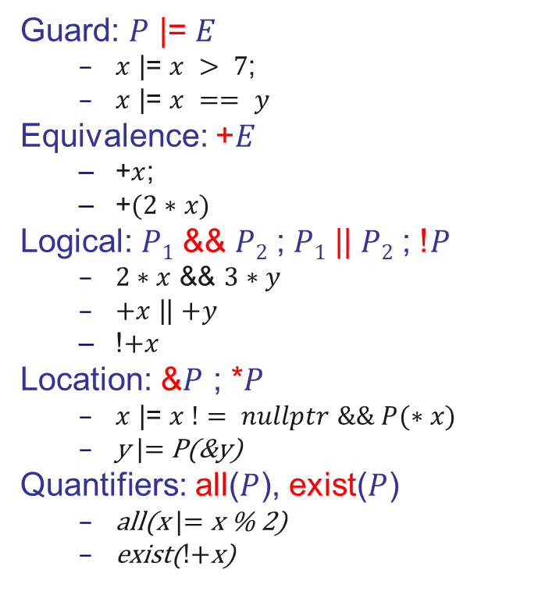
Mach7: Pattern Combinators
Operators for:
creating new patterns
modifying existing ones
combining patterns and lazy expressions
Guard: $P$ |= $E$
$x$ |= $x > 7$;
$x$ |= $x == y$
Equivalence: +$E$
+$x$;
+$(2∗x)$
Logical: $P1$ && $P2$ ; $P1$ || $P2$ ; !$P$
$2∗x$ && $3∗y$
$+x$ || $+y$
!$+x$
Location: &$P$ ; *$P$
$x$ |= $x != nullptr \&\& P(∗x)$
y |= P(&y)
Quantifiers: all($P$), exist($P$)
all(x |= x % 2)
exist(!+x)
Notes:
The equivalence combinator is only one of the pattern combinators commonly used in other languages (e.g. Thorn, Grace). Pattern combinators constitute operators for creating new patterns and modifying the meaning of existing ones. A guard combinator, for example, combines a pattern with a lazily evaluated guard into a guard pattern. Similarly, conjunction, disjunction and negation combinators allow one to compose patterns logically. Mach7 also introduces a few combinators specific to C++, which help deal with pointers.

Slide 19
Mach7: Balancing Red-Black Tree
class T{ enum color{black,red} col; T* left; K key; T* right; };
T* balance(T::color clr, T* l, const K& key, T* r)
{
const T::color B = T::black, R = T::red;
var<T*> a, b, c, d; var<K&> x, y, z; T::color col;
Match(clr, l, key, r)
{
Case(B, C<T>(R, C<T>(R, a, x, b), y, c), z, d) return ...;
Case(B, C<T>(R, a, x, C<T>(R, b, y, c)), z, d) return ...;
Case(B, a, x, C<T>(R, C<T>(R, b, y, c), z, d)) return ...;
Case(B, a, x, C<T>(R, b, y, C<T>(R, c, z, d))) return ...;
Case(col, a, x, b) return new T{col, a, x, b};
}
EndMatch
}
Where ... ≡ new T{R, new T{B,a,x,b}, y, new T{B,c,z,d}};
Notes:
Combined together, you can see that our open patterns allow us to express the functional solution to balancing red-black trees as tersely as it is known in the functional community.

Slide 20
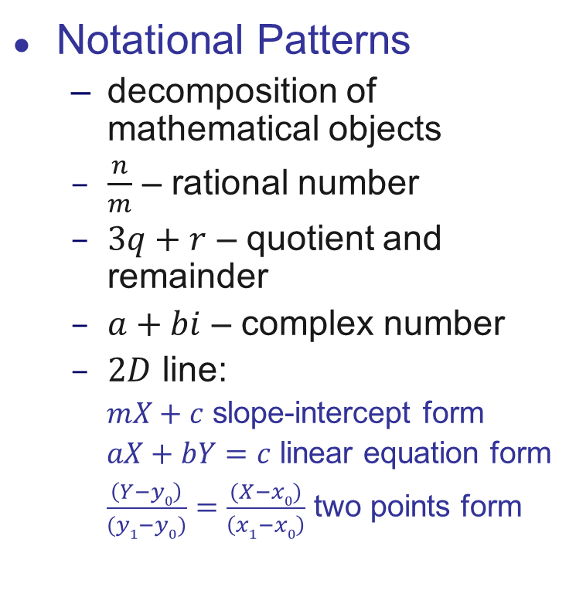
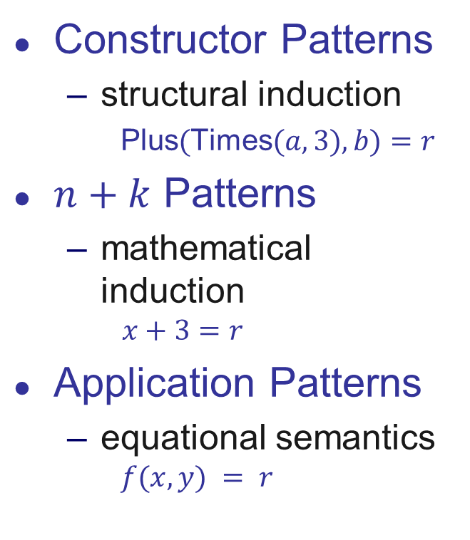
Mach7: Algebraic Decomposition
Constructor Patterns
structural induction
Plus$($Times$(a,3),b)=r$
$n+k$ Patterns
mathematical induction
$$x+3=r$$
Application Patterns
equational semantics
$$f(x,y) = r$$
Notational Patterns
decomposition of mathematical objects
$\frac{n}{m}$ – rational number
$3q+r$ – quotient and remainder
$a+bi$ – complex number
$2D$ line:
$mX+c$ slope-intercept form
$aX+bY=c$ linear equation form
$\frac{\left(Y−y0\right)}{(y1−y0)}=\frac{(X−x0)}{\left(x1−x0\right)}$ two points form
Notes:
Rod Burstall coined the idea of constructor patterns to explicitly facilitate structural induction on terms in order to be able to prove some properties about programs. With Peano construction of natural numbers, the idea was soon generalized to n+k patterns in order to facilitate the mathematical induction on natural numbers. Further attempts to generalize this idea included application patterns, which try to give such patterns equational semantics. The semantics of application patterns is obvious when the solution to corresponding equation is unique or absent, but when multiple solution exist, additional, often obscure and complicated rules, have to be put in place. Instead of trying to generalize algebraic decomposition along the equational route, we suggest to interpret them as notational patterns that help the programmer decompose parts of a mathematical objects with a well established notation known for such entity. For example, n/m is a common notation for rational numbers, which can be used to decompose an object representing a rational number into nominator and denominator. Similarly, a+bi is a common notation for decomposing complex numbers, while 3q+r can be used to obtain quotient and remainder of dividing a number by 3. More complex mathematical objects may have even more complex notations, like for example, 2D line that can be represented with slope-intercept, linear equation or two points form. Note that in the last 2 cases the equality sign is already embedded into the notation, making it hard to consider the equational semantics.

Slide 21
Mach7: Algebraic Decomposition
double power(double x, int n)
{
var<int> m;
Match(n)
{
Case(0) return 1.0;
Case(1) return x;
Case(2*m) return sqr(power(x,m));
Case(2*m+1) return x*sqr(power(x,m));
}
EndMatch
}
size_t gcd(const size_t a, const size_t b)
{
var<size_t> x;
Match(a,b)
Case(_,a) return a;
Case(_,a+x) return gcd(a,x);
Case(b+x,_) return gcd(b,x);
EndMatch
}
Equational reasoning
Since n is of integral type:
n=2*m → n must be even and m=n/2
n=2*m+1 → n must be odd and m=(n-1)/2
Type matters
b+x=a for unsigned x will match only when b > a
Notes:
Interestingly, the notational semantics of generalized n+k patterns allows us to express the useful cases of application patterns with their equational semantics. The following function implements fast algorithm for computing x^n and mimics almost one to one the mathematical definition from the book. The explicitness of variable pattern helps in this case as we can take the type of the underlying variable into account when providing the semantics of matching against a given expression. This allows us to reject matches for integral types and simply solve the equation when underlying type is a field. This is further demonstrated in the slow subtraction algorithm for GCD computation where for unsigned x the expression b+x will match the first argument a only when b > a.

Slide 22
Mach7: Other Patterns
var<int> n,m,y,d,m;
auto month = m |= m > 0 && m < 13; // Save pattern to variable
auto day = d |= d > 0 && d < 31; // Day pattern
Match(s)
{
Case(rex("([0-9]+)-([0-9]+)-([0-9]+)", 979)) // Local phone
Case(rex("([0-9]+)-([0-9]+)-([0-9]+)",
any({800,888,877,866,855}), n, m) // Toll-free phone
Case(rex("([0-9]{4})-([0-9]{2})-([0-9]{2})",
y, month, d |= d > 0 && d <= 31)) // Date
Otherwise() // Something else
}
EndMatch
All Patterns in the library are user-defined
Patterns can be saved in variables and passed to functions
Notes:
As we mentioned, the library does not rely on a set of pre-existing patterns and can be used with new patterns that are easy to create. Using the new regular expression class of C++11 we could quickly create a regular expression pattern that can be composed with other patterns and used inside the Match statement. The patterns can also be saved into variables as demonstrated here with month and day and then reused inside other patterns. The Match statement you see can be used to parse and check the string for being a local phone, a toll-free phone and a valid date.

Slide 23
Patterns-subjects interaction
match e with
[0,1,2] ->
| [x] ->
| [_,y,(0|1)] ->
| x:y:tail ->
| x+1:2*y:tail ->
| x:y:tail when x=y ->
| _ -> …
;;
Group by subject
Check
Introduce & bind variables
Compose patterns
Structurally decompose
Algebraically decompose
Restrict
Perform actions
etc…
Notes:
To better design the C++ equivalent of pattern matching, let us first have a closer look at the interaction of patterns with subjects in other languages. Here is a not quite the Ocaml syntax, since some of the patterns shown here are not actually supported by Ocaml.

Slide 24
Always nice to have
Type checking/inference
Openness to new patterns and combinators
Openness to built-in and user-defined types
Support of various ADT encodings
Efficiency in matching
Redundancy checking
Exhaustiveness checking
Extensible Notation
Implicit Variable introduction
Notes:
There are also certain features of the language related to pattern matching that would be nice to have if at all possible in C++.

Slide 25
Idea: Patterns as Objects
struct object { // root of the object class hierarchy
virtual bool operator==(const object&) const = 0;
};
struct pattern { // pattern interface
virtual bool match(const object&) = 0;
};
Run-time composition of patterns
Pros
Open patterns
First-class patterns
Dynamic composition
Cons
Intrusive
Type errors at run-time
Extremely slow
Notes:
The idea of open patterns is not new and has been explored before. In object-oriented languages it is usually based on two interfaces: object and pattern. The object interface is used to check equivalence of two values, while the pattern interface provides match function that is implemented by each specific pattern kind. The patterns in this case are composed at run-time and allow for dynamic composition of patterns based on user input.
The problem with this solution is that is intrusive as it assumes all the classes that participate in pattern matching to be derived from a single base class. Type errors are only discovered at run-time. Most importantly however, the approach is extremely slow in comparison to handcrafted solution, as we will see shortly.

Slide 26
Patterns as Expression Templates
template <typename... P>
struct some_pattern : std::tuple<P...> {
some_pattern(P&&...);
template <typename S> bool operator()(const S& s) const;
};
Compile-time composition of patterns
Pros
Open patterns
First-class patterns
Non-intrusive
Type errors at compile-time
Cons
No run-time composition
Notes:
Our patters are also implemented as objects, however these objects do not have to belong to any class hierarchy. Instead they all have to model a Pattern concept, which typically amounts to implementing a constructor taking sub-patterns, a type-function to benefit from type switching and an application operator implementing the actual matching logic.
The solution is non-intrusive as neither values nor patterns have to belong to a given class hierarchy. Incorrect applications of patterns to subjects or invalid pattern compositions are reported at compile time (mostly with nice messages from static_assert, but occasionally with cryptic ones). The main disadvantage in comparison to the “Patterns as Objects” approach is that because pattern composition happens at compile time, the patterns cannot be composed based on user input. This is the case however with most of the languages with predefined set of patterns, and is generally expected from a pattern matching mechanism of a language.

Slide 27
Mach7 Concepts
Pattern
template <typename P>
constexpr bool Pattern() {
return Copyable<P>
&& is_pattern<P>::value
&& requires (typename S, P p, S s)
{
bool = { p(s) };
AcceptedType<P,S>;
};
}
LazyExpression
template <typename E>
constexpr bool LazyExpression() {
return Copyable<E>
&& is_expression<E>::value
&& requires (E e)
{
ResultType<E>;
ResultType<E> == { eval(e) };
ResultType<E> { e };
};
}
Notes:
Pattern composition in Mach7 is built on top of two concepts: Pattern and LazyExpression, shown here in some early syntax for the ConceptLite proposal.
A class modeling Pattern concept must be Copyable and explicitly state its membership by specializing is_pattern trait. It should have an application operator defined for all such subject types S that are applicable to the given pattern. The result of application operator should be convertible to bool. The class should also have a type function AcceptedType<P,S> usually implemented as P::accepted_type_for<S>::type, that for any subject type S would indicate the accepted type, to which the conversion should be performed first before matching. This is necessary to let Mach7 patterns to interact with the efficient type switch construct used under the hood.
A class modeling a LazyExpression concept is used to capture the structure of a lazily evaluated expression that can be used both in the LHS and RHS of a matching construct (classes modeling only Pattern can only be used in the LHS). Similarly, it should be Copyable, must explicitly state its membership by specializing is_expression template and should provide an associated type ResultType, usually implemented as E::result_type, indicating the type of the result of lazy expression’s evaluation. There should also exist an overload of the function eval for the given expression E capable of eagerly evaluating it. The result of evaluation must be convertible to E::result_type. There must be also an implicit conversion operator to E::result_type that simply calls eval in order to let the lazy expression be used directly in the RHS.

Slide 28
Primitive Patterns
/// Wildcard pattern
struct wildcard
{
template <typename T>
bool operator()(const T&) const noexcept
{
return true;
}
};
/// Value pattern
template <class T>
struct value
{
T m_value; // Value to compare to
explicit value(const T& t) : m_value(t) {}
bool operator()(const T& t) const {
return m_value == t;
}
};
/// Variable pattern
template <class T>
struct var
{
mutable T m_value; // Bound value
var() : m_value() {}
/// bind the value and accept match
bool operator()(const T& t) const {
m_value = t;
return true;
}
/// What if type of subject is different?
template <typename U>
bool operator()(const U& u) const
{
m_value = u;
return m_value == u;
}
};
Notes:
We now demonstrate how the primitive wildcard, value and variable patterns can be implemented in Mach7. The wildcard pattern can be applied to any subject type, which is why its application operator is parameterized over subject type. Alternatively we could have implemented it with variadic argument list … but that had weird behavior in certain cases. Value pattern stores the constant to compare to and its application operator simply compares to that constant. Variable pattern stores the value that will be bound and simply assigns it in the application operator. Note that when the type of the subject is different from the type of variable pattern, we can choose to implement the conversion during assignment, but then verify that the value after conversion still equals to the original subject. This is one way to implement it, we will see later that in case of polymorphic class it would make sense to do dynamic_cast, while some users might opt to implement logic that disallows second assignment to allow variable patterns be used directly as equivalence patterns.

Slide 29
Structural Decomposition: Bindings
User defines bindings by specializing
template <typename T> struct bindings;
For example, for classes:
template <> struct bindings<Value> { Members(Value::value); };
template <> struct bindings<Plus> { Members(Plus::e1, Plus::e2); };
After Members-macro substitution
template <> struct bindings<Plus> {
static auto member1() noexcept { return &Plus::e1; }
static auto member2() noexcept { return &Plus::e2; }
};
Allows us to access members by position in bindings:
T* t = ...;
auto s2 = apply_member(t, bindings<T>::member2()); // apply_member is overloaded by different kinds of member pointers
Notes:
Before we can implement constructor patterns, we need a way to decompose user-defined types into sub-components. The operation is dual to constructor and in the literature is often called deconstructor. We decided not to use the term deconstructor as it is already misused among newbies to refer to destructor. Note that unlike destructor, deconstructor does not destroy the object – it simply tries to infer the parts it was constructed from. In Mach7 the user defines decomposition of a class by specializing bindings template for his class, in which he lists the memers in order they should be bound. After macro substitution the Member generates functions that return a corresponding pointer to member. The member pointer can either be a data member, a unary free function taking T as an argument or a nullary member-function. The position is embedded here into the name for demonstration purposes, it can be parameterized over. In order to access a given member the library generates call to apply_member function which takes subject and result of a call to corresponding binding extractor and than through overload applies the member pointer to the subject.

Slide 30
Constructor Pattern
template <typename T, typename P1, typename P2>
struct constr2 /// Constructor/Type pattern of 2 arguments
{
P1 m_p1; ///< Pattern representing 1st operand
P2 m_p2; ///< Pattern representing 2nd operand
constr2(const P1& p1, const P2& p2) : m_p1(p1), m_p2(p2) {}
bool operator()(const T& t) const {
return m_p1(apply_member(t, bindings<T>::member1())) ///< Apply 1st sub-pattern to 1st argument
&& m_p2(apply_member(t, bindings<T>::member2()));///< Apply 2nd sub-pattern to 2nd argument
}
template <typename U>
bool operator()(const U& u) const { ///< When subject type is different
auto t = dynamic_cast<const T*>(&u); ///< Enabled only for polymorphic T and U
return t && operator()(*t);
}
};
template <typename T, typename P1, typename P2> ///< Syntactic helper
auto C(P1&& p1, P2&& p2) { return constr2<T, P1, P2>(forward<P1>(p1), forward<P2>(p2)); }
Notes:
The implementation of constructor pattern is now simple, demonstrated here for a constructor pattern of 2 sub-patterns. The actual implementation can use variadic templates. The constructor pattern takes sub-patterns as arguments and explicitly moves them into members. Its application operator tries to match sub-patterns in order by applying them to the result of extracting corresponding bindings from the subject. Helper function C allows us to simplify the syntax to simply C<T>(…) for constructor patterns.

Slide 31
Algebraic Decomposition
/// Expression pattern for binary operation
template <typename F, typename E1, typename E2>
struct expr
{
static_assert(is_expression<E1>::value, "Argument E1 must be a lazy expression");
static_assert(is_expression<E2>::value, "Argument E2 must be a lazy expression");
typedef ...F(E1,E2)... result_type; ///< Type of result when used in expression.
/// Type function returning type accepted by the pattern for a given subject type S.
template <typename S> struct accepted_type_for { typedef result_type type; };
/// Eagerly evaluate in the right-hand side
operator result_type() const { return eval(*this); }
template <typename U>
bool operator()(const U& u) const { return solve(*this,u); }
E1 m_e1; ///< Expression template with the 1st operand
E2 m_e2; ///< Expression template with the 2nd operand
};
Notes:
Algebraic decomposition is not much more elaborate. Notice that the expression now have to model both: the Pattern and the LazyExpression concept. Pattern’s application operator simply forwards the call to a generic solve function, which will be discussed in the next slide, while the implementation of LazyExpression part is pretty straightforward.

Slide 32
Algebraic Decomposition
template <LazyExpression E, typename S>
inline bool solve(const E&, const S&) noexcept
{
static_assert(std::is_same<E,S>::value,"There is no solver for matching E(S)”);
return false;
}
template <LazyExpression E, typename T>
requires Field<typename E::result_type>()
bool solve(const mult<E,value<T>>& e, const E::result_type& r)
{ return solve(e.m_e1,r/eval(e.m_e2)); } // e.m_e2 is c
template <LazyExpression E, typename T>
requires Integral<typename E::result_type>()
bool solve(const mult<E,value<T>>& e, const E::result_type& r) {
T c = eval(e.m_e2); // e.m_e2 is c
return r%c == 0 && solve(e.m_e1,r/c);
}
Notes:
Overloading the solve function is Mach7 way of letting the user define the semantics of his notational patterns through algebraic decomposition. By default solve function simply asserts that the user did not provide the necessary overload (the dummy condition is always false). We use ConceptLite syntax for concept-based overloading here, but you can imagine how those are actually implemented in the library with enable_if right now.
The user can now choose to implement his semantics. For types with unique inverse (those modeling Field) he may choose to invert the expression of the form (E*c)=r to simply be solved against r/c for E pattern since the division is unique. For integral types where there is no unique inverse for division, the user might specialize that the pattern would only be accepted if c divides r evenly. Corresponding overloads are provided for commutative expressions of the form c*E, but with them this is all the Mach7 has to define to fully implement the generalized n+k patterns we used earlier in the power(x,n) example.

Slide 33
What can we do so far?
Explicitly declare primitive patterns
var<const Expr&> a, b, c, d; wildcard _;
Decompose objects by composing patterns
Expr& expr = ...; if (C<Times>(a, _)(expr)) { ... }
Nest patterns:
if (C<Plus>(C<Times>(a, _), C<Times>(c, val(0)))(expr)) {...}
The matching syntax is somewhat lame
if (C<Times>(a, b)(expr)) { ... } else if (C<Divide>(_, val(0))(expr)) { ... } else
if (C<Plus>(C<Times>(a, _), C<Times>(c, val(0)))(expr)) {...}
Notes:
So far we explicitly introduce primitive patterns, compose patterns and apply them to subject via some inconvenient syntax.

Slide 34
With macros and meta-programming
Explicitly declare primitive patterns
var<const Expr&> a, b, c, d; wildcard _;
Decompose objects by composing patterns
Expr& expr = ...; if (C<Times>(a, _)(expr)) { ... }
Nest patterns:
if (C<Plus>(C<Times>(a, _), C<Times>(c, 0))(expr)) {...}
The matching syntax is somewhat better
Match(expr) Case(C<Times>(a, b)) ... Case(C<Divide>(_, 0)) ...
Case(C<Plus>(C<Times>(a, _), C<Times>(c, 0))) ... EndMatch
Notes:
Turns out the syntax can be improved with macros that generate the previous structure. We can also use traditional template meta-programming tricks to allow the use of constants and variables in expression templates directly.

Slide 35
Cool Syntax Bro!
Must be slow
Sequential execution
Definitely slow when dynamic_cast is involved
Instantiates tons of temporaries
Re-matches same sub-patterns on same subjects
Does not check for redundancy
What would exhaustiveness mean here?
Does my pattern composition make sense?
What if I don’t use polymorphic classes?
Notes:
While the syntax is better, it doesn’t seem to be generating any efficient code. In what follows we will demonstrate how Mach7 performs the matching efficiently as well as will address some of these other issues. Here is our first optimization that doesn’t require any assumptions about semantics of concrete patterns.

Slide 36
Memoization Device: Check Once!
Hypothetical Statement
Execute the 1st statement s_{i} whose predicate P_{i} is true
switch (x) {
case P₁(x): s₁;
...
case P_{n}(x): s_{n};
}
Memoize
Clause of the 1st successful predicate
Assume
Functional behavior
NOTE: The code is generated!
typedef decltype(x) T;
static hash_map<T,size_t> labels;
switch (size_t& l = labels[x])
{
default: // we have not seen x yet
if (P₁(x)) { l = 1; case 1: s₁; }
else
...
if (P_{n}(x)) { l = n; case n: s_{n}; }
else l = n+1;
case n+1: // none is true on x
}
Notes:
Consider a slightly more general problem: execute the first statement, whose guard predicate is true. Providing the predicates do not have side effects, the same clause will be executed for the same value of x. We can thus memoize the clause enabled for a particular value and re-execute it directly on subsequent runs with the same x.
The actual control structure, which we call “Memoization Device” is automatically generated by macros and represents an interleaving of a cascading-if statement with the switch-statement. The mapping of values to case clauses is stored in a global hash table, which default initializes elements to 0 upon first access. Values not yet in the hash table will fall into the default clause and trigger the sequential execution of the cascading if-statement. The first predicate that evaluates to true will save its clause number in the corresponding element of the hash table for subsequent calls.
The obvious drawback of this solution is the size of the hash table that will be proportional to the number of values seen, however often times the values can be grouped into equivalence classes with values in the same class rendering the same outcomes for all the predicates, allowing us to store the equivalence class instead.

Slide 37
Expression Problem
+
*
6
exp ::= val | exp + exp | exp - exp | exp * exp | exp / exp
Functional Languages
type expr =
Value of int
| Plus of expr * expr
| Minus of expr * expr
| Times of expr * expr
| Divide of expr * expr ;;
let rec eval e =
match e with
Value v -> v
| Plus (a,b) -> (eval a) + (eval b)
| Minus (a,b) -> (eval a) - (eval b)
| Times (a,b) -> (eval a) * (eval b)
| Divide(a,b) -> (eval a) / (eval b) ;;
Easy to add new functions
Adding new variants is intrusive
7
2
Object-Oriented Languages
class Expr { virtual int eval(); };
class Value : Expr { int value; };
class Plus : Expr { Expr &e1, &e2; };
class Minus : Expr { Expr &e1, &e2; };
class Times : Expr { Expr &e1, &e2; };
class Divide: Expr { Expr &e1, &e2; };
int Value::eval() { return value; }
int Plus ::eval() { return e1.eval()+e2.eval(); }
int Minus::eval() { return e1.eval()-e2.eval(); }
int Times::eval() { return e1.eval()*e2.eval(); }
int Divide::eval(){ return e1.eval()/e2.eval(); }
Easy to add new variants
Adding new functions is intrusive
};
Notes:
Type switching is related to a well known expression problem that can be demonstrated on the following example.
Imagine that you would like to implement an interpreter (or calculator) of a simple expression language represented by this grammar.
In functional languages, a term in the expression language will typically be represented with a recursive ADT with variants corresponding to production rules. In object-oriented languages, a term in the expression language will usually be represented with an abstract base class with derived classes representing the corresponding variants.
Functional languages then implement various operations on expression terms (like evaluation, printing or transformation) by simple case analysis on the variants. Object-oriented languages, on the other hand, will introduce a virtual function per each operation into the base class. The function is then overridden by each variant (derived class) to implement the logic of the operation on that specific variant.
One may notice that it is easy to add new operations on expression terms in functional languages, but adding new variants (i.e. productions here) requires modification of the ADT and all the existing functions on it. The situation is dual for object-oriented languages – it is easy to add new variants, but adding new operations require modification of the base class and all the existing variants.
This duality is known as the “expression problem” and have been extensively studied in the literature.

Slide 38
Functional Style Case Analysis
exp ::= val | exp + exp | exp - exp | exp * exp | exp / exp
type expr =
Value of int
| Plus of expr * expr
| Minus of expr * expr
| ...
;;
let rec eval e =
match e with
Value v -> v
| Plus(a,b) -> (eval a) + (eval b)
| Minus(a,b)-> (eval a) - (eval b)
| ...
;;
Pros
Elegant
Intuitive
Extensibility of functions
Checked
redundancy
exhaustiveness
Local reasoning
Relational
Cons
No extensibility of data
Not suitable for classes:
Variants are closed & disjoint
Classes are extensible & hierarchical
Notes:
Consider an interpreter (or calculator) of a simple expression language represented by this grammar.
In functional languages, a term in the expression language will typically be represented with a recursive algebraic data type with variants corresponding to production rules. Algebraic data types are closed (no variants can be added later) and disjoint (value belongs to only one variant). Because of this, various operations on expression terms (like evaluation, printing or transformation) can be implemented by simple case analysis on the variants and the compiler can check the exhaustiveness of it.
Notice that in functional languages it is easy to add new operations on expression terms, but adding new variants (i.e. productions here) requires modification of the algebraic data type and all the existing functions on it.

Slide 39
Object-Oriented Decomposition
exp ::= val | exp + exp | exp - exp | exp * exp | exp / exp
class Expr {
virtual int eval();
};
class Value : Expr {
int eval() { return value; }
int value;
};
class Plus : Expr {
int eval() {
return e1.eval()+e2.eval();
}
Expr& e1; Expr& e2;
};
Pros
Modularity
Encapsulation
Extensibility of data
Works in the presence of
multiple inheritance
dynamic linking
Cons
No extensibility of functions
No local reasoning
Non-relational
Notes:
In object-oriented languages, a term in the expression language will usually be represented with an abstract base class with derived classes representing the corresponding production rules. We then introduce a virtual function per each operation into the base class. The function is then overridden by each derived class to implement the logic of the operation on that specific variant.
Unlike algebraic data types, classes are extensible and hierarchical. Extensibility means that new variants can be added later, including at run-time in the presence of dynamic linking. The fact that classes are hierarchical means that a given value may belong to numerous variants. The situation is thus dual for object-oriented languages – it is easy to add new variants, but adding new operations require modification of the base class and all the existing variants. This duality is known as the “expression problem” and have been extensively studied in the literature.

Slide 40
ADT in C++: Polymorphic Encoding
class Expr { virtual ~Expr() {} };
class Value : Expr { int value; };
class Plus : Expr { Expr& e1, &e2; };
class Minus : Expr { Expr& e1, &e2; };
class Times : Expr { Expr& e1, &e2; };
class Divide: Expr { Expr& e1, &e2; };
int eval(Expr& e)
{
if (Value* p = dynamic_cast<Value* >(&e))
return p->value;
if (Plus* p = dynamic_cast<Plus* >(&e)) return eval(p->e1) + eval(p->e2);
if (Minus* p = dynamic_cast<Minus* >(&e)) return eval(p->e1) - eval(p->e2);
if (Times* p = dynamic_cast<Times* >(&e)) return eval(p->e1) * eval(p->e2);
if (Divide* p = dynamic_cast<Divide*>(&e)) return eval(p->e1) / eval(p->e2);
return 0; // assert(0) or throw(something)
}
Pros
somewhat intuitive
type safe
local reasoning
independent extensibility of data
substitutability
non-intrusive
Cons
no checking
slow
verbose
Notes:
The encoding of algebraic data types that we just saw is called in the literature “Polymorphic encoding”. It uses polymorphic classes to represent variants and dynamic_cast to analyze them. It has certain pros and cons but is certainly not the only common encoding of the ADTs.

Slide 41
ADT in C++: Tag Encoding
class Expr { int m_tag; Expr(int t):m_tag(t){} };
class Value : Expr { enum{tag=1}; int value; };
class Plus : Expr { enum{tag=2}; Expr*e1,*e2; };
class Minus : Expr { enum{tag=3}; Expr*e1,*e2; };
class Times : Expr { enum{tag=4}; Expr*e1,*e2; };
class Divide: Expr { enum{tag=5}; Expr*e1,*e2; };
int eval(const Expr* e)
{
switch (e->m_tag)
{
case Value::tag: { Value* p = static_cast<Value*> (e);
return p->value; }
case Plus::tag: { Plus* p = static_cast<Plus*> (e);
return eval(p->e1) + eval(p->e2); }
case Minus::tag: { Minus* p = static_cast<Minus*> (e);
return eval(p->e1) - eval(p->e2); }
case Times::tag: { Times* p = static_cast<Times*> (e);
return eval(p->e1) * eval(p->e2); }
case Divide::tag: { Divide* p = static_cast<Divide*>(e);
return eval(p->e1) / eval(p->e2); }
}
}
Pros
somewhat intuitive
fast
local reasoning
controlled extensibility of data
Cons
not type safe
no checking
no substitutability
verbose
intrusive
Notes:
Another common encoding still uses derived classes to represent variants, however it explicitly embeds a tag into the base class to distinguish the variants. The case analysis is then usually done with a switch statement with explicit static casts.

Slide 42
ADT in C++: Discriminated Union Enc.
struct Expr
{
enum {Value,Plus,Minus,Times,Divide} m_tag;
union {
struct { int value; };
struct { Expr* e1; Expr* e2; };
};
};
int eval(const Expr* e)
{
switch (e->m_tag)
{
case Value: return e->value;
case Plus: return eval(e->e1)+eval(e->e2);
case Minus: return eval(e->e1)-eval(e->e2);
case Times: return eval(e->e1)*eval(e->e2);
case Divide:return eval(e->e1)/eval(e->e2);
}
}
Pros
intuitive
fast
local reasoning
Cons
not type safe
no checking
not hierarchical
no extensibility of data
Notes:
Discriminated union encoding uses tagged union and is more of a C relic, however it is still used quite often due to tools like yacc and bison using it under the hood.

Slide 43
Visitor Design Pattern
// Forward declare cases
struct Value; struct Plus; struct Minus; struct Times; struct Divide;
// Cases interface
struct Visitor {
virtual void caseValue (const Value& ) {}
virtual void casePlus (const Plus& ) {}
virtual void caseMinus (const Minus& ) {}
virtual void caseTimes (const Times& ) {}
virtual void caseDivide(const Divide&) {}
};
// Implementation of variants (omitting data members etc.)
struct Expr { virtual void accept(Visitor& v) const = 0; };
struct Value : Expr { void accept(Visitor& v) const { v.caseValue (*this); } … };
struct Plus : Expr { void accept(Visitor& v) const { v.casePlus (*this); } … };
struct Minus : Expr { void accept(Visitor& v) const { v.caseMinus (*this); } … };
struct Times : Expr { void accept(Visitor& v) const { v.caseTimes (*this); } … };
struct Divide : Expr { void accept(Visitor& v) const { v.caseDivide(*this); } … };

Slide 44
Visitor Design Pattern
int eval(const Expr& e)
{
struct EvalVisitor : Visitor // Visitor implementing case analysis for evaluation
{
int result; // Variable where result of evaluation will be stored
void caseValue (const Value& e) { result = e.value; }
void casePlus (const Plus& e) { result = eval(e.e1) + eval(e.e2); }
void caseMinus (const Minus& e) { result = eval(e.e1) - eval(e.e2); }
void caseTimes (const Times& e) { result = eval(e.e1) * eval(e.e2); }
void caseDivide(const Divide& e) { result = eval(e.e1) / eval(e.e2); }
};
EvalVisitor v; // Instantiate evaluation visitor
e.accept(v); // Pass it to accept method on e to find out case of e
return v.result; // Return the result of case analysis
}

Slide 45
Visitor Design Pattern
class Value; class Plus; ...
class Visitor {
virtual void visit(Value&)= 0;
virtual void visit(Plus&) = 0;
// ...
};
class Expr {
virtual void accept(Visitor&); };
class Value : Expr {
void accept(Visitor& v) { v.visit(*this); }
};
// ...
// Forward declaration of known variants
class Value; class Plus; class Minus; class Times; class Divide;
// Visitation interface
class Visitor
{
virtual void visit(const Value&) = 0;
virtual void visit(const Plus&) = 0;
virtual void visit(const Minus&) = 0;
virtual void visit(const Times&) = 0;
virtual void visit(const Divide&) = 0;
};
// Abstract base and known derived classes
class Expr { virtual void accept(Visitor&); };
class Value : Expr { void accept(Visitor& v) { v.visit(*this); } int value; };
class Plus : Expr { void accept(Visitor& v) { v.visit(*this); } Expr& e1, &e2; };
class Minus : Expr { void accept(Visitor& v) { v.visit(*this); } Expr& e1, &e2; };
class Times : Expr { void accept(Visitor& v) { v.visit(*this); } Expr& e1, &e2; };
class Divide: Expr { void accept(Visitor& v) { v.visit(*this); } Expr& e1, &e2; };
// Actual implementation of eval with visitor design pattern
int eval(const Expr& e)
{
struct EvalVisitor : Visitor
{
int result;
void visit(const Value& e) { result = e.value; }
void visit(const Plus& e) { result = eval(e.e1) + eval(e.e2); }
void visit(const Minus& e) { result = eval(e.e1) - eval(e.e2); }
void visit(const Times& e) { result = eval(e.e1) * eval(e.e2); }
void visit(const Divide& e) { result = eval(e.e1) / eval(e.e2); }
} v;
e.accept(v);
return v.result;
}
Pros
Extensibility of functions
Speed
Library solution
Cons
Hard to teach
Intrusive
Specific to hierarchy
Lots of boilerplate code
Control inversion
Hinders extensibility of classes
Notes:
Visitor design pattern was an attempt to combine the benefits of both worlds and it certainly had few advantages:
a solution to extensibility of functions
an overhead of only 2 virtual function calls
and being a library solution
Unfortunately it is intrusive (because we have to inject some virtual functions), specific to class hierarchy, introduces control inversion and, most importantly, hinders extensibility of classes by fixing the set of variants. You can see on the right that it requires a lot of boilerplate code to be written and is surprisingly hard to teach to students.
This demonstrates the amount of code that has to be written to implement eval function with the help of visitor design pattern.

Slide 46
Polymorphic Exception Idiom
class Expr { virtual void raise() = 0; };
class Value : Expr { void raise() { throw(*this); } };
class Plus : Expr { void raise() { throw(*this); } };
class Minus : Expr { void raise() { throw(*this); } };
class Times : Expr { void raise() { throw(*this); } };
class Divide: Expr { void raise() { throw(*this); } };
int eval(Expr& e)
{
try { e.raise(); }
catch(Value & e) { return e.value; }
catch(Plus & e) { return eval(e.e1) + eval(e.e2); }
catch(Minus & e) { return eval(e.e1) - eval(e.e2); }
catch(Times & e) { return eval(e.e1) * eval(e.e2); }
catch(Divide& e) { return eval(e.e1) / eval(e.e2); }
}
Pros
checked: redundancy
type safe
local reasoning
independent extensibility of data
substitutability
Cons
slow
intrusive
Notes:
During design of ML2000 people suggested that pattern matching on extensible data types can be handled in the same way as exception handling. Turns out this can be modeled in C++ with what is called polymorphic exception idiom. It is still intrusive and works similarly to visitor design pattern except that there is no control inversion and visit methods become catch handlers. Unfortunately, as we will see soon this results in very poor performance. This by no mean means that exception handling is inefficient in C++, it is inefficient because we use it for common case, not for the exceptional one.

Slide 47
Closer to common syntax, but …
ADT encodings
Polymorphic
Tagged
Discriminated Union
Ways of handling them
Cascading-if
Visitor Design Pattern
Polymorphic Exception Idiom
Hierarchy Linearization
Switch
Syntactic Form
Match(expr)
Case(P₁) ...
Case(P_{n}) ...
Otherwise() ...
EndMatch
Can generate most
first-fit or all-fit
relies on forwarding
unique top-level
no multiple inheritance
no substitutability

Slide 48
Variations within Syntactic Form
Encoding+Handling | Substitutability | Relational | Repeat Case | Multiple Inheritance | Speed
Poly+if | + | + | + | + | 577
Poly+memoization device | + | + | + | + | 62
Tag+switch | - | - | - | - | 42
Tag+linearization | * | - | - | - | 45
Union+switch | - | - | - | n/a | 39
Poly+visitors | * | - | - | + | 55
Poly+exceptions | + | - | - | + | 17K
Match(expr)
Case(P₁) ...
Case(P_{n}) ...
Otherwise() ...
EndMatch
Notes:
Turns out the syntactic form we picked up is powerful enough to support all of the mentioned encodings and ways of handling them with some restrictions. Mach7 does that so that you are not limited by the choice of your encoding, however if you are going to choose an encoding, the following table will summarize for you the limitations you should be aware of.
Substitutability indicates whether the particular handling scheme is capable of handling derived classes in case clauses accepting the base class.
Support of relational matching indicates whether Match statement can deal with more than one argument for that particular encoding/handling.
Repeat Case indicates whether you can have 2 or more case clauses with root class being the same. Try/Catch for example wouldn’t allow same class twice, so usually for these encodings the library asks the users to use sub-clauses to make sure the root class only happens one.
Multiple Inheritance indicates whether encoding/handling will be capable of dealing with multiple inheritance.
As you can see, only the polymorphic encoding provides you all the benefits, which is why we recommend library users use it. It is also the only type-safe alternative in the table.

Slide 49
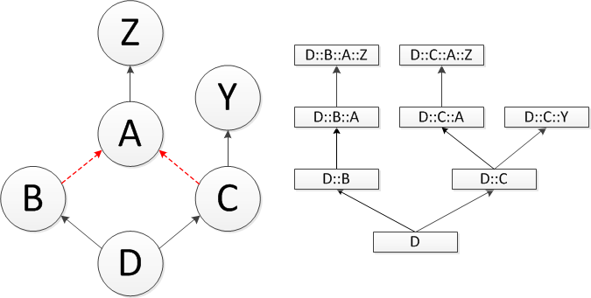
Problem of Open Type Switching
Classes are:
Extensible
Important: Separate compilation
Important: Dynamic linking
Hierarchical
Multiple Inheritance
Up-, down- and cross-casts
Cast is not a no-op
Ambiguities
Existing approaches
Closed world: jump tables
Unrealistic for modern C++ use
Open world: constant-time subtype tests + decision trees
Most are not suitable for repeated multiple inheritance
Most require computations or run-time code generation at load time
Time increases with case number
Notes:
There are several problems to efficient implementation of type switching in object-oriented languages.
Unlike ADT, classes are extensible and hierarchical. Extensibility means that the compiler can never assume the closed world as the new variants can be added later, including at run-time in the presence of dynamic linking. The fact that classes are hierarchical means that variants are not necessarily disjoint and that the solution should be able to match more specific variants against more general ones in the case clause. The general multiple inheritance of C++ complicates the matter even further. The type inclusion tests as well as the outcomes of related type casts in such scenario become dependent on the notion of sub-object and the sub-object graph induced by different kinds of multiple inheritance present in C++.
Existing approaches to type switching are either efficient or open, but not both. Efficient approaches rely on closed world assumption, which is unrealistic for modern use of C++. Open approaches rely on constant-time subtype tests combined with decision trees. Unfortunately most of the known constant-time type tests are not suitable for repeated multiple inheritance and require non-trivial computations at load time in order to keep the solution open. Independently of these, the time increases with the case number because of the underlying decision tree, which quickly surpasses the time of known workaround for even small number of case clauses.

Slide 50
Open but Inefficient Solution
switch (object)
{
case Type₁: action₁;
case Type₂: action₂;
...
case Type_{n}: action_{n};
}
if (Type₁* match=dynamic_cast<T₁*>(object)) { action₁; } else
if (Type₂* match=dynamic_cast<T₂*>(object)) { action₂; } else
...
if (Type_{n}* match=dynamic_cast<T_{n}*>(object)) { action_{n}; }
Notes:
Instead of starting with a known efficient solution and trying to make it open, we start with a known open solution and try to make it efficient. The cascading-if at the bottom implements the first-fit semantics of the type switch on the top in truly open fashion. This happens because the implementation of dynamic_cast operator is open to class extensions.
Unfortunately the solution takes thousands of cycles for large case clauses, even when optimized with a decision tree, which is disproportionately larger than only 20 cycles used by the visitor design pattern. This happens because on one side we repetitively check the same dynamic type, while on the other – we do not learn anything from it.

Slide 51
Problem of Efficient Type Switching
Fast Dynamic Cast
Cohen’s Algorithm
Binary Matrix
Visitors
Open Type Switch
C Switch on integers
Notes:
Efficient approaches that rely on closed world assumption typically implement the switch with jump table over small consecutive integers as demonstrated in chart with “C Switch on integers”.
Open approaches rely on constant-time subtype tests combined with decision trees, as demonstrated in chart with “Fast Dynamic Cast”, “Cohen’s Algorithm” and “Binary Matrix”. Unfortunately most of the known constant-time type tests are not suitable for repeated multiple inheritance and require non-trivial computations at load time in order to keep the solution open. Independently of these, for Match statements with many case clauses the time to uncover the type is not constant and increases with the case number because of the underlying decision tree. It quickly surpasses the time of known workarounds for even small number of case clauses.
Our solution provides amortized constant time discovery that is faster than visitor’s constant time discovery.

Slide 52
Key Features of Our Solution
Memoization device
Maps types to execution paths
Uses dynamic types of objects
Hash of dynamic type
A pointer to a virtual function table (v-table) identifies
Type of object
Sub-object offset
High-quality hashing needed for performance
Experiments to achieve perfect and/or compact hashing
We use the structure of v-table pointers
Notes:
The solution we offer relies on the following key points:
A mechanism for mapping values to executions paths
A property of the C++ object model that lets us distinguish particular sub-objects within an object
Non random structure of the v-table pointers that helps us make the solution efficient

Slide 53
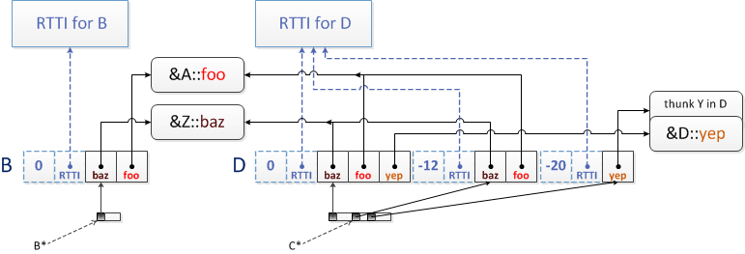
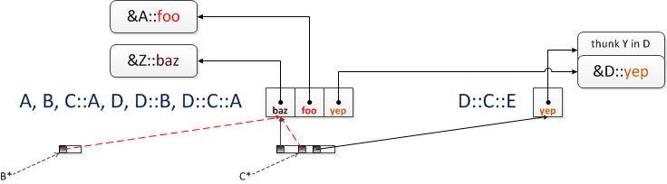
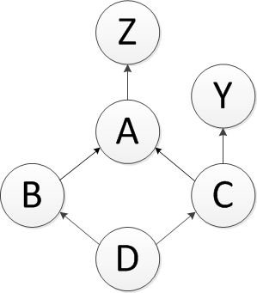
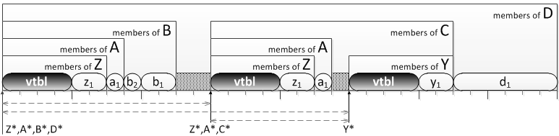
Uniqueness of V-Table Pointers
Notes:
To be able to use memoization device for our purposes we need to be able to identify not only the dynamic type of an object, but also a sub-object within it, since an object may have several different sub-objects of the same static type. The following diagram shows a typical layout of object of type D under repeated multiple inheritance, which is a recursive composition of layouts of its base classes as well as its own members. While C++ does not require to use any particular technique to implement virtual functions, most of the compilers use virtual tables and embed a v-table pointer at a known offset into every class with virtual functions. Let us look at what those pointers are pointing to in what is called a “Common Vendor ABI”.
At positive offsets from the v-table pointer we have function pointers implementing virtual functions. At negative offsets we have a pointer to RTTI, offset to top of the object, offsets to virtual base classes etc. Since the content of a v-table is read-only, the compiler may unify parts of the table when they are the same. This is a common optimization technique when the use of RTTI is disabled. We can see now that the same v-table is reused by several different classes and sub-objects of the same class.
Nevertheless, we show in the paper that under the requirements of a common vendor ABI and in the presence of RTTI the v-table pointers are guaranteed to be unique for sub-objects of the same static type. This is easy to see from the picture because objects of different dynamic types will have to have different RTTI pointers in their v-tables, while different sub-objects of the same object will have different offset to top.

Slide 54
Intermediate Solution
We use:
source sub-object as a hash map key
P_{i}(x) ≡ dynamic_cast<T_{i}*>(x)!=0
We map it to:
offset to target sub-object
jump target
On first entry
memoize this-pointer offset
memoize jump target
On subsequent entries
jump to target
adjust this-pointer
struct info {
ptrdiff_t offset;
size_t target;
};
// Case(T_{i}* t) ----- T_{i} ≡ Type_{i} -----
if (auto t = dynamic_cast<T_{i}*>(x)) {
n.offset = int(t)-int(x);
n.target = i;
case i:
auto match =
adjust_ptr<T_{i}>(x,n.offset);
s_{i};
}
Notes:
We use uniqueness of vtbl-pointers in combination with memoization device to implement type switch. Note:
All objects coming through a given Match statement have the same static type
We rely on dynamic_cast to perform casts and C++ requires presence of RTTI when dynamic_cast is used.
vtbl-pointers thus uniquely identify source sub-objects and target sub-objects
We use sub-objects as an equivalence class that does not change the outcome of dynamic_cast and map them to a pair of offset between the source and target sub-objects and the jump target. We use vtbl-pointers to uniquely identify sub-objects in our implementation.
On first entry (sequential execution of cascading if) we memoize offset and jump target
On subsequent runs we simply jump directly to memoized target and adjust this-pointer with memoized offset

Slide 55
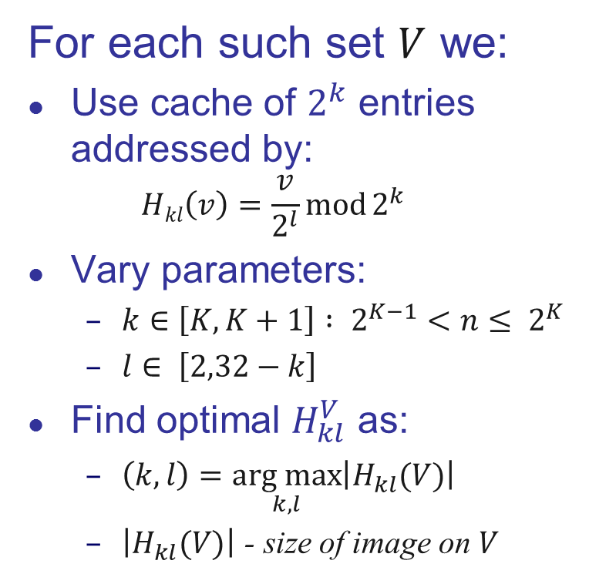
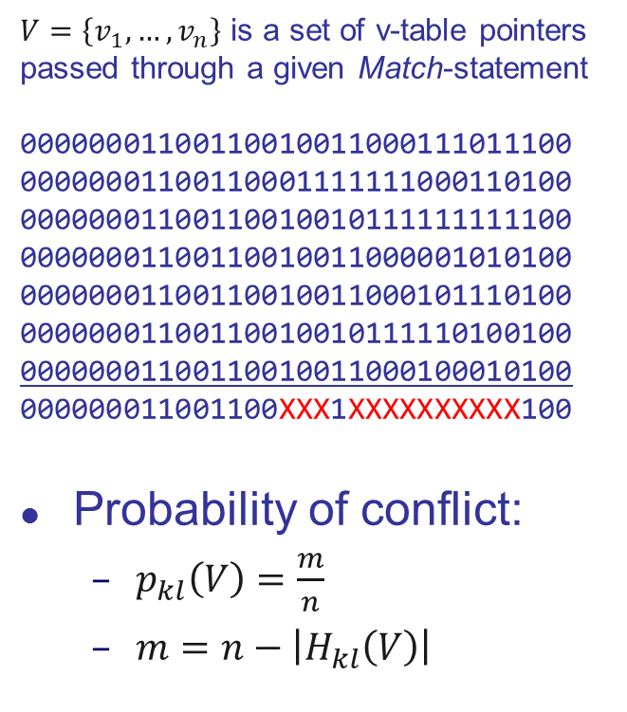
Structure of V-Table Pointers
$V=\left\{v_{1},…,v_{n}\right\}$ is a set of v-table pointers passed through a given Match-statement
00000001100110010011000111011100
00000001100110001111111000110100
00000001100110010010111111111100
00000001100110010011000001010100
00000001100110010011000101110100
00000001100110010010111110100100
00000001100110010011000100010100
000000011001100XXX1XXXXXXXXXX100
Probability of conflict:
$p_{kl}\left(V\right)=\frac{m}{n}$
$m=n−\left|H_{kl}\left(V\right)\right|$
For each such set $V$ we:
Use cache of $2^{k}$ entries addressed by:
$$Hkl\left(v\right)=\frac{v}{2^{l}}\operatorname{mod}{2^{k}}$$
Vary parameters:
$k∈\left[K,K+1\right] : 2^{K−1}<n≤ 2^{K}$
$l∈ \left[2,32−k\right]$
Find optimal $H_{kl}^{V}$ as:
$\left(k,l\right)=\underset{k,l}{arg max}\left|H_{kl}(V)\right|$
$\left|H_{kl}(V)\right|$ - size of image on $V$
V=
n
k
k
l
l
Notes:
The intermediate solution works, but as is it is still about 50% slower than visitors. We use the structure of v-table pointers to narrow the gap.
We look at a set of v-table pointers that come through a given Match-statement and identify the bits they are different in. The idea is to use a cache of 2^{k} entries and a simple hashing function that gets rid of common bits on the right, however the size of such cache can be too large to justify the use. We thus fix k to be not larger than twice the closest power of 2 for the number of actual v-table pointers seen. We then let l be chosen in such a way as to minimize the probability of conflict (which is the same as to maximize the number of occupied cache entries).

Slide 56
Handling Multiple Arguments
Morton Order (Z-order)
a function that maps N-dimensional data to one dimension while preserving locality of the data points
obtained by interleaving the binary representations of all coordinates
Parameters: k,l₁,…,l_{N}
Minimize probability of conflict
But not every reconfiguration!
Notes:
To handle multiple arguments we resort to Morton order to preserve the hashing properties of vtbl-pointers on their Cartesian product. It amounts to interleaving the bits of all the arguments. We then keep the same parameter k, but we store a different optimal offset per each argument. It is important to not try to find optimal parameters during each reconfiguration of cache, only to improve them. This allows us to maintain overall amortized performance, while over time saturates to the same optimal parameters.

Slide 57
Visitors Comparison
Lnx: Dell Dimension® desktop with
Intel® Pentium® D (Dual Core) CPU at 2.80 GHz; 1GB of RAM; Fedora Core 13
G++ 4.4.5 executed with -O2; x86 binaries
Win: Sony VAIO® laptop with
Intel® Core™i5 460M CPU at 2.53 GHz; 6GB of RAM; Windows 7 Pro.
G++ 4.6.1 / MinGW executed with -O2; x86 binaries
MS Visual C++ 2010 Professional x86/x64 binaries with and without Profile-Guided Optimizations
 |  | Open |  |  |  |  |  | Closed
 |  | G++ |  | MS Visual C++ |  |  |  | G++ |  | MS Visual C++
 |  | Lnx | Win | PGO |  | w/o PGO |  | Lnx | Win | PGO |  | w/o PGO
 |  | x86-32 | x86-32 | x86-32 | x86-64 | x86-32 | x86-64 | x86-32 | x86-32 | x86-32 | x86-64 | x86-32 | x86-64
 | REP | 16% | 14% | 1% | 18% | 2% | 37% | 124% | 122% | 100% | 41% | 76% | 37%
 | SEQ | 56% | 12% | 48% | 22% | 2% | 46% | 640% | 467% | 29% | 15% | 30% | 10%
 | RND | 56% | 0% | 9% | 19% | 5% | 46% | 603% | 470% | 35% | 20% | 32% | 6%
Forwarding | REP | 33% | 22% | 8% | 17% | 24% | 36% | 53% | 49% | 24% | 11% | 20% | 36%
 | SEQ | 55% | 233% | 135% | 135% | 193% | 32% | 86% | 290% | 48% | 139% | 12% | 24%
 | RND | 78% | 25% | 3% | 4% | 13% | 23% | 88% | 33% | 8% | 1% | 18% | 16%
Each number represents a median of 101 experiments timing 1,000,000 dispatches each
18% - percentage visitors are faster by
14% - percentage type switch is faster by
Notes:
We now compare the performance of our approach to the performance of visitor design pattern. Numbers in blue indicate cases when type switch was faster than visitors while numbers in red indicate cases when visitors were faster than type switch. The 3 usage scenarios represent various call patterns that we found in different applications.
Presence of forwarding indicates a common technique in visitor design pattern where default implementation of visit methods for derived classes forwards the call to visit of its base class. This is equivalent to matching objects of derived class against their base classes in case clauses. Visitors become slower in the presence of forwarding due to additional virtual function call, while type switch generally becomes faster due to smaller jump tables.
Performance of our library solution benefits significantly from branch hinting, which can be indicated to G++ with some intrinsic functions. Unfortunately Visual C++ does not have a similar facility and they recommend to use Profile Guided Optimizations to achieve the same effect. This is why we provide the numbers for Visual C++ with and without Profile Guided Optimizations.
To give an idea about absolute timing, the following chart shows the comparison of absolute values leading to these relative ones. The actual bars represent the timings of visitors and type switch without forwarding while the black lines show where the corresponding bar would be in the presence of forwarding. It is easy to see that in case of repetitive benchmark both timings are significantly smaller because of the hardware cache. Visitors become slower in the presence of forwarding due to additional virtual function call, while type switch generally becomes faster due to smaller jump tables.
Finally, our library allows users to benefit from cases when the corresponding class hierarchy is known to be closed.

Slide 58
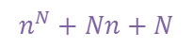
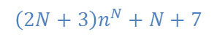
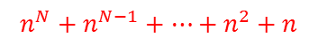
Multi-Argument Comparison
n is the number of subobjects in a class hierarchy of arguments
Memory:
$$n^{N}+n^{N−1}+…+n^{2}+n$$
$$\left(2N+3\right)n^{N}+N+7$$
$$n^{N}+Nn+N$$
GCC 4.5.2
GCC 4.6.1
GCC 4.7.2
Visual C++ 10
Visual C++ 11
Notes:
Finally, in application to relational matching we wanted to see how our solution compares to visitor-based implementations (double, triple, quadruple dispatch) as well as our own implementation of multi-methods for C++, which enable such relational checks.
It is easy to see that the solution based on the visitor design pattern was generally slower than the same solution based on pattern matching, which in turn was slower than the multi-methods based solution.
While all the solutions used the amount of memory of the same magnitude O(n^{N}), the coefficients were quite different. Contrary to the common belief, multi-methods take less memory than the equivalent solution based on visitor design pattern. While type switch was using the most memory, the values are written for the worst case: the size of type switch grows proportionally to the number of actual argument pairs seen, while both N-Dispatch and open multi-methods essentially pre-allocate for the worst case all the time.

Slide 59
Other Languages Comparison
Our library code is approximately as fast as natively compiled functional code. We will squeeze even more with a language solution.
Note: This is not a detailed language comparison, but we compare well with “the gold standard” for pattern matching
Notes:
We also did comparison of our technique against performance of pattern matching on closed algebraic data types of OCaml and Haskell and you can see that our solution is almost as efficient, while maintaining openness.

Slide 60
Real World Class Hierarchies
Lib | Language | Classes | Paths | Height | Roots | Leafs | Both | Parents |  | Children
 |  |  |  |  |  |  |  | avg | max | avg | max
DG2 | Smalltalk | 534 | 534 | 11 | 2 | 381 | 1 | 1 | 1 | 3.48 | 59
DG3 | Smalltalk | 1356 | 1356 | 13 | 2 | 923 | 1 | 1 | 1 | 3.13 | 142
ET+ | C++ | 370 | 370 | 8 | 87 | 289 | 79 | 1 | 1 | 3.49 | 51
GEO | Eiffel | 1318 | 13798 | 14 | 1 | 732 | 0 | 1.89 | 16 | 4.75 | 323
JAV | Java | 604 | 792 | 10 | 1 | 445 | 0 | 1.08 | 3 | 4.64 | 210
LOV | Eiffel | 436 | 1846 | 10 | 1 | 218 | 0 | 1.72 | 10 | 3.55 | 78
NXT | Objective-C | 310 | 310 | 7 | 2 | 246 | 1 | 1 | 1 | 4.81 | 142
SLF | Self | 1801 | 36420 | 17 | 51 | 1134 | 0 | 1.05 | 9 | 2.76 | 232
UNI | C++ | 613 | 633 | 9 | 147 | 481 | 117 | 1.02 | 2 | 3.61 | 39
VA2 | Smalltalk | 3241 | 3241 | 14 | 1 | 2582 | 0 | 1 | 1 | 4.92 | 249
VA2 | Smalltalk | 2320 | 2320 | 13 | 1 | 1868 | 0 | 1 | 1 | 5.13 | 240
VW1 | Smalltalk | 387 | 387 | 9 | 1 | 246 | 0 | 1 | 1 | 2.74 | 87
VW2 | Smalltalk | 1956 | 1956 | 15 | 1 | 1332 | 0 | 1 | 1 | 3.13 | 181
Overalls |  | 15246 | 63963 | 17 | 298 | 10877 | 199 | 1.11 | 16 | 3.89 | 323
% sub-hierarchies | 1% | 3% | 5% | 10% | 20% | 25% | 50% | 64% | 100%
with more than … classes | 700 | 110 | 50 | 20 | 10 | 7 | 3 | 2 | 1
Notes:
Since the performance of our solution relies in part on the structure of v-table layout by the compiler, we wanted to make sure that we do not make oversimplifying assumptions that result in that property. We thus took a class hierarchy benchmark that was used before to evaluate the speed of various run-time dispatching techniques. The most important property of this benchmark for us was that all the classes were written by humans. There was about 15K classes in the benchmark with about 64K paths (see sub-objects).
Type switch as well as visitor design pattern are generally applied to non-leaf classes only. 71% of the classes in the entire benchmarks suite were leaf classes. Out of the 4369 non-leaf classes, 36% were spawning a sub-hierarchy of only 2 classes (including the root), 15% – a sub-hierarchy of 3 classes, 10% of 4, 7% of 5 and so forth, which can be seen in the following chart. Turning this into a cumulative distribution, a% of sub-hierarchies had more than b classes in them, which reflects the percentage of real-world use cases with given number of case clauses.

Slide 61
Efficiency of Hashing
4369 type switches
87.5% of them rendered a hash function with no conflicts
Conflicts | 0 | 1 | 2 | 3 | 4 | 5 | 6 | >6
Type Switches | 87.50% | 5.58% | 2.63% | 0.87% | 0.69% | 0.69% | 0.30% | 1.76%
Notes:
For each of the 4369 non-leaf classes we generated a type-switch performing case analysis of all possible derived classes. The tests as well as classes were distributed among multiple translation units.
We put a dot in the picture based on the number of actual sub-objects (vtbl-pointers) that came through a given type switch and the computed probability of conflict that was achieved by that type switch using the optimal parameters k and l of its hashing function. We used shadow to show points where numerous experiments had the same outcome.
The most important observation here is that in 87.5% of cases the optimal hash function rendered no conflicts at all – these are the experiments lying on X axis. In other words only in 12.5% of cases the optimal functions had any conflicts at all.

Slide 62
Interaction of Patterns & Type Switch
Mach7 considers
Is Case-clause a valid pattern?
Which subjects are polymorphic?
What is expected type of the subject?
template <typename... P>
struct some_pattern : std::tuple<P...> {
static_assert(conjunction<is_pattern<P>...>::value,“Not a pattern");
some_pattern(P&&... p);
template <typename S> struct accepted_type_for { typedef S type; };
template <typename S> bool operator()(const S& s) const;
};
Notes:
Our patters are also implemented as objects, however these objects do not have to belong to any class hierarchy. Instead they all have to model a Pattern concept, which typically amounts to implementing a constructor taking sub-patterns, a type-function to benefit from type switching and an application operator implementing the actual matching logic.
The solution is non-intrusive as neither values nor patterns have to belong to a given class hierarchy. Incorrect applications of patterns to subjects or invalid pattern compositions are reported at compile time (mostly with nice messages from static_assert, but occasionally with cryptic ones). The main disadvantage in comparison to the “Patterns as Objects” approach is that because pattern composition happens at compile time, the patterns cannot be composed based on user input. This is the case however with most of the languages with predefined set of patterns, and is generally expected from a pattern matching mechanism of a language.

Slide 63
Pattern Matching Overhead
15% - percentage hand crafted code is faster by 15% - percentage pattern matching code is faster by
 |  | Patterns as Expr. Templ. |  |  |  |  | Patterns as Objects
 |  | G++ |  |  | Visual C++ |  | G++ |  |  | Visual C++
Test | Patterns | 4.5.2 | 4.6.1 | 4.7.2 | 10 | 11 | 4.5.2 | 4.6.1 | 4.7.2 | 10 | 11
factorial₀ | 1,v,_ | 15% | 13% | 17% | 85% | 35% | 347% | 408% | 419% | 2121% | 1788%
factorial₁ | 1,v | 0% | 6% | 0% | 83% | 21% | 410% | 519% | 504% | 2380% | 1812%
factorial₂ | 1,n+k | 7% | 9% | 6% | 78% | 18% | 797% | 911% | 803% | 3554% | 3057%
fibonacci | 1,n+k,_ | 17% | 2% | 2% | 62% | 15% | 340% | 431% | 395% | 2730% | 2597%
gcd₁ | v,n+k,+ | 21% | 25% | 25% | 309% | 179% | 1503% | 1333% | 1208% | 8876% | 7810%
gcd₂ | 1,n+k, | 5% | 13% | 19% | 373% | 303% | 962% | 1080% | 779% | 5332% | 4674%
gcd₃ | 1,v | 1% | 0% | 1% | 38% | 15% | 119% | 102% | 108% | 1575% | 1319%
lambdas | &,v,C,+ | 58% | 54% | 56% | 29% | 34% | 837% | 780% | 875% | 259% | 289%
power | 1,n+k | 10% | 8% | 13% | 50% | 6% | 291% | 337% | 338% | 1950% | 1648%
Our Solution
Previous Approaches
Notes:
To estimate the overhead of both approaches to pattern matching we compared a code written with patterns and an equivalent code without patterns implementing the same algorithm. As can be seen on the right, patterns implemented with “Patterns as objects” approach introduce significant overhead over the hand-crafted code. This is not the case with our approach, where the overhead is fairly small. In some cases, our approach even produced faster code, indicated in lighter blue font in the table.

Slide 64
Compilation Time Overhead
15% - handcrafted compilation is faster by 15% - pattern matching compilation is faster by
 |  | Patterns as Expr. Templ. |  |  | Patterns as Objects
 |  | G++ | Visual C++ |  | G++ | Visual C++
Test | Patterns | 4.7.2 | 10 | 11 | 4.7.2 | 10 | 11
factorial₀ | 1,v,_ | 1.65% | 1.65% | 2.95% | 7.10% | 10.00% | 10.68%
factorial₁ | 1,v | 2.46% | 1.60% | 10.92% | 7.14% | 0.00% | 1.37%
factorial₂ | 1,n+k | 2.87% | 3.15% | 3.01% | 8.93% | 4.05% | 3.83%
fibonacci | 1,n+k,_ | 3.66% | 1.60% | 2.95% | 11.31% | 4.03% | 1.37%
gcd₁ | v,n+k,+ | 4.07% | 4.68% | 0.91% | 9.94% | 2.05% | 8.05%
gcd₂ | 1,n+k, | 1.21% | 1.53% | 0.92% | 8.19% | 2.05% | 2.58%
gcd₃ | 1,v | 2.03% | 3.15% | 7.86% | 5.29% | 2.05% | 0.08%
lambdas | &,v,C,+ | 18.91% | 7.25% | 4.27% | 4.57% | 3.82% | 0.00%
power | 1,n+k | 2.00% | 6.40% | 3.92% | 8.14% | 0.13% | 4.02%
Notes:
Several people have also expressed their concerns that since our solution is based on templates, the compilation times will increase significantly. We measured the impact of compiling both approaches against compiling the hand-crafted code and did not find any significant increase in compilation times. This is expected as implementation of our patterns does not rely on complex meta-programming and in most of the cases amount to straightforward top-down instantiation of templates.

Slide 65
Pivot’s C++ Pretty-printer: Speed
Header | LOC | Faster Time | Performance | Header | LOC | Faster Time | Performance
climits | 44 | 765 | 15.26% | cmath | 338 | 5909 | 3.4%
cassert | 47 | 781 | 16.09% | cwchar | 430 | 6956 | 3.86%
cerrno | 50 | 894 | 11.79% | functional | 588 | 6352 | 2.39%
cstdarg | 51 | 301 | 21.64% | iosfwd | 981 | 14699 | 2.17%
csignal | 53 | 1061 | 8.17% | utility | 1095 | 15848 | 2.3%
cstddef | 55 | 943 | 12.29% | limits | 1521 | 20512 | 1.53%
cfloat | 61 | 1188 | 10.44% | valarray | 1551 | 30552 | 1.1%
csetjmp | 65 | 1172 | 8.33% | iterator | 2356 | 29158 | 2.65%
cctype | 98 | 1667 | 3.01% | numeric | 2481 | 30545 | 3.7%
cwctype | 98 | 2137 | 10.88% | memory | 3171 | 38761 | 4.33%
ctime | 104 | 1714 | 8.74% | stdexcept | 3907 | 50049 | 3.49%
exception | 107 | 1803 | 10.02% | algorithm | 5467 | 63553 | 3.37%
cstring | 144 | 2560 | 2.03% | deque | 5477 | 68619 | 2.75%
typeinfo | 145 | 2267 | 8.11% | stack | 5563 | 68893 | 3.22%
new | 156 | 2255 | 7.94% | list | 5981 | 72341 | 3.63%
cstdio | 195 | 3482 | 1.58% | vector | 5985 | 73268 | 3.94%
cstdlib | 195 | 3211 | 0.86% | queue | 9851 | 115871 | 3.6%
Notes:
To quantify the performance of the library on a real application, we rewrote an existing visitors-based application, which was implementing a C++ pretty-printer for the Pivot framework. The pretty-printer was fed as an input the standard header files from MS Visual C++ 2003. We indicate the number of lines of code in each file because it is roughly proportional to the number of nodes in the final AST. The numbers in red indicate that visitor design pattern was faster by corresponding percentage points then pattern matching solution. The numbers in blue indicate that pattern matching solution was faster than visitors by that much. As you can see, for relatively small files the visitors were faster because of the initial cost in type switching. However, already after 1000 lines of codes the pattern-matching solution was dominating the performance.

Slide 66
Pivot’s C++ Pretty-printer: Memory
Notes:
There was 8 match statements in the pretty printer, each of which was encoded before with visitors. The largest statement had 63 case clauses with 52 different node kinds coming through it. Here we see the amount of memory each of 8 type switches in Pivot’s pretty printer took one of the largest standard headers. We can also see the number of actual cache hits and misses while looking up vtbl-pointers in the switch’ data structure.

Slide 67
Mach7: Problems w/ STL Containers
STL containers are not recursive data structures
They are not expressed in terms of themselves
Ranges also are not
But they can represent subparts of themselves
We need patterns describing sets, sequences, collections of values
Notes:
Mach7 deals with recursive data types almost as expressively as functional languages. Unfortunately standard containers in STL are not recursive datatypes. While ranges are also not recursive (since they are not expressed in terms of themselves), they can represent a subset of themselves, which is what is important for case analysis since we reduce the complexity of the data structure on each recursive call.

Slide 68
Mach7: Problems w/ STL Containers
struct List : Term { Term* head; List* tail; };
struct Structure : Term {
std::string name; std::vector<Term*> terms;
};
bool operator==(const Term& l, const Term& r) {
var<std::string> s; var<int> n; var<const Term&> h,t; // rng<????> p;
Match(l,r)
Case(C<List>(&h,&t), C<List>(&+h,&+t) ) return true;
Case(C<List>(&h,nullptr), C<List>(&+h,nullptr) ) return true;
//Case(C<Structure>(s,n,p), C<Structure>(+s,+n,all(+**p++))) return true;
...
EndMatch
}
Notes:
Currently we do not have patterns that decompose STL containers in a useful way, but we keep looking for similar patterns in other languages with containers. One idea of such patterns is indicated in the above commented out code, however even with support of ranges its feasibility is not established yet as the type of the range will have to be explicitly specified since it is not in deducible context.

Slide 69
Conclusions
Open Pattern Matching for C++:
Open (w.r.t. Patterns & Objects analyzed)
Faster than alternatives (visitors, patterns as objects)
Non-intrusive
Mach7:
A Library Solution
Open Sourced under BSD license: http://parasol.tamu.edu/mach7/ will eventually live here: https://github.com/solodon4/SELL
Currently works for G++ 4.4+ and Visual C++ 2010+
A Roadmap for Future Language Solution
A baseline for features
A baseline for performance
Transition for implementations
A hope that future Object-Oriented languages will consider including support for pattern matching a-priori instead of a-posteriori
Notes:
In conclusion, we presented a solution to open pattern matching in C++, which allows for both openness of patterns and objects being analyzed. It is faster than alternatives and can be applied retroactively. The current solution is a library implemented in standard C++ that is available as open source under BSD license.
The current solution is already competitive & we expect the forthcoming built-in support to be even better. In the meantime we plan to use it as a base line for features and performance evaluation of the actual language solution. We hope that experiences obtained in this implementation will also convince authors of future object-oriented languages to consider including pattern matching a-priory as many of the techniques used are applicable to broader set of languages.

Slide 70
Ongoing and Future Work
Ongoing
Fix Clang support
Lock-free vtbl-map
boost::variant etc.
Sequence patterns
Improved type-checking
Improved diagnostics
Older compilers
Future
Generic redundancy checking
Generic implication
Two-way matching
Language feature
Notes:
The following list indicates ongoing work prioritized by people’s requests along with some future work prioritized by our interest in it.

Slide 71
References
Most details
Y.Solodkyy. "Simplifying the Analysis of C++ Programs" Ph.D. Thesis. Texas A&M University. August 2013. [pdf, slides]
Y.Solodkyy, G.Dos Reis, B.Stroustrup. "Open Pattern Matching for C++: Extended Abstract" In Proceedings of the 2013 companion publication for conference on Systems, programming, & applications: software for humanity (SPLASH '13). ACM, New York, NY, USA, pp. 97-98. [pdf, slides, notes, poster, project]
Y.Solodkyy, G.Dos Reis, B.Stroustrup. "Open Pattern Matching for C++" In Proceedings of the 12th international conference on Generative programming: concepts & experiences (GPCE '13). ACM, New York, NY, USA, pp. 33-42. [pdf, slides, notes, poster, project]
Y.Solodkyy, G.Dos Reis, B.Stroustrup. "Open and Efficient Type Switch for C++" In Proceedings of the ACM international conference on Object Oriented Programming Systems Languages and Applications (OOPSLA '12). ACM, New York, NY, USA, pp. 963-982. [pdf, slides, notes, poster, extras, project]
All of the above is available on my university page: https://parasol.tamu.edu/~yuriys/
Notes:
The details about this work can be found in the following publications, available on my university page. Most details, not discussed in the academic papers, are available in my PhD thesis.

Slide 72

Thank You!
Old: http://parasol.tamu.edu/mach7/ Soon: https://github.com/solodon4/SELL
E-mail: yuriy.solodkyy@gmail.com
Acknowledgements
Abe Skolnik
Andrew Sutton
Bjarne Stroustrup
Emil 'Skeen' Madsen
Gabriel Dos Reis
Gregory Berkolaiko
Jaakko Järvi
Jason Wilkins
Jasson Casey
Michael Lopez
Karel Driesen
Lawrence Rauchwerger
Luc Maranget
Peter Pirkelbauer
Sergiy Butenko
Suhasini Subba Rao
Vahideh Kamranzadeh
Xavier Leroy
Microsoft
Notes:
We would like to acknowledge numerous individuals who helped with this publication, the library and evaluation of its use. I would also like to acknowledge my new employer, Microsoft, for accommodating this travel.

Slide 73
Approaches to Dealing with AST
 | Extensibility of Functions | Extensibility of Data | Type Safe | Multiple Inheritance | Relational | Nesting | Retroactive | Local Reasoning | No Control Inversion | Redundancy Checking | Completeness Checking | Speed in Cycles
Discriminated Union | + | − | − | − | − | − | − | + | + | − | * | 39
Tag Switch | + | * | − | − | − | − | − | + | + | − | − | 45
Type Testing | + | + | + | + | − | − | + | + | + | − | − | 577
Polymorphic Exception | + | + | + | + | − | − | − | + | + | * | * | 17K
Virtual Functions | − | + | + | + | − | − | − | − | − |  | − | 29
Visitor Design Pattern | + | * | + | + | * | − | − | + | − |  | − | 55
Open Multi-methods | + | + | + | + | + | − | + | − | − |  | + | 38
Open Type Switch | + | + | + | + | + | − | + | + | + | * | − | 62
Open Pattern Matching | + | + | + | + | + | + | + | + | + | * | − | 70
Notes:
To summarize capabilities of existing and our approaches to dealing with abstract syntax trees, we listed several desirable properties that applications dealing with abstract syntax trees benefit from and marked whether a given approach fully, partially or doesn’t support that property. It is easy to see that our solutions support the most properties among other solutions, while together they cover them all. The approaches are also reasonably efficient in comparison to others.

